Slide 1









My Number Interactive Notebook
$$×$$
$$\frac{1}{2}$$
$$÷$$
$$+$$
$$−$$
$$\frac{3}{5}$$
$$7$$
Name
Class
Teacher
Term 1 Semester 1
$$5^{2}$$
$$\sqrt{9}$$
1

Slide 2
Contents
Glossary or Formula Page
Page
Date
Description
2
3

Slide 3
Tasks
24
7
30
Essential Question
Questions
Notes
Summary

Slide 4

24
7
30
Date
Multiplying Fractions
EQ – How do you cancel common factors to multiply fractions?
What is the process for multiplying fractions?
Write any mixed fracions as a improper fraction.
Cancel any common factors between the numerators and the denominators.
Multiply the numerators and multiply the denominators.
Simplify.
$$2\frac{4}{5}×\frac{5}{7}$$

Slide 5
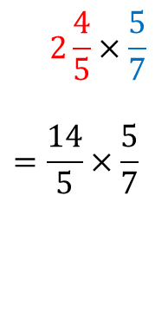
24
7
30
Date
Multiplying Fractions
EQ – How do you cancel common factors to multiply fractions?
What is the process for multiplying fractions?
Write any mixed fracions as a improper fraction.
Cancel any common factors between the numerators and the denominators.
Multiply the numerators and multiply the denominators.
Simplify.
$$2\frac{4}{5}×\frac{5}{7}$$
$$=\frac{14}{5}×\frac{5}{7}$$

Slide 6
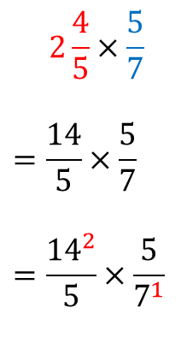
24
7
30
Date
Multiplying Fractions
EQ – How do you cancel common factors to multiply fractions?
What is the process for multiplying fractions?
Write any mixed fracions as a improper fraction.
Cancel any common factors between the numerators and the denominators.
Multiply the numerators and multiply the denominators.
Simplify.
$$2\frac{4}{5}×\frac{5}{7}$$
$$=\frac{14}{5}×\frac{5}{7}$$
$$=\frac{{14}^{2}}{5}×\frac{5}{7^{1}}$$

Slide 7
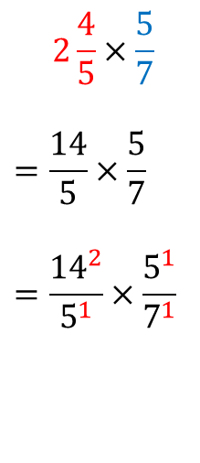
24
7
30
Date
Multiplying Fractions
EQ – How do you cancel common factors to multiply fractions?
What is the process for multiplying fractions?
Write any mixed fracions as a improper fraction.
Cancel any common factors between the numerators and the denominators.
Multiply the numerators and multiply the denominators.
Simplify.
$$2\frac{4}{5}×\frac{5}{7}$$
$$=\frac{14}{5}×\frac{5}{7}$$
$$=\frac{{14}^{2}}{5^{1}}×\frac{5^{1}}{7^{1}}$$

Slide 8
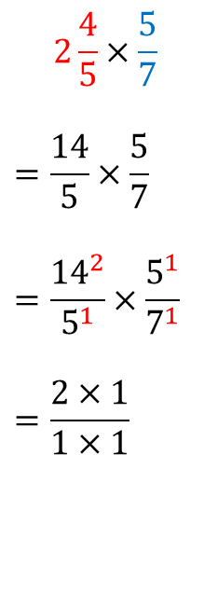
24
7
30
Date
Multiplying Fractions
EQ – How do you cancel common factors to multiply fractions?
What is the process for multiplying fractions?
Write any mixed fracions as a improper fraction.
Cancel any common factors between the numerators and the denominators.
Multiply the numerators and multiply the denominators.
Simplify.
$$2\frac{4}{5}×\frac{5}{7}$$
$$=\frac{14}{5}×\frac{5}{7}$$
$$=\frac{{14}^{2}}{5^{1}}×\frac{5^{1}}{7^{1}}$$
$$=\frac{2×1}{1×1}$$

Slide 9
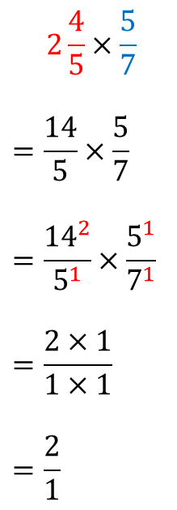
24
7
30
Date
Multiplying Fractions
EQ – How do you cancel common factors to multiply fractions?
What is the process for multiplying fractions?
Write any mixed fracions as a improper fraction.
Cancel any common factors between the numerators and the denominators.
Multiply the numerators and multiply the denominators.
Simplify.
$$2\frac{4}{5}×\frac{5}{7}$$
$$=\frac{14}{5}×\frac{5}{7}$$
$$=\frac{{14}^{2}}{5^{1}}×\frac{5^{1}}{7^{1}}$$
$$=\frac{2×1}{1×1}$$
$$=\frac{2}{1}$$

Slide 10
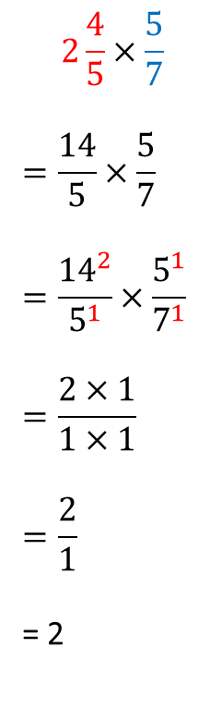
24
7
30
Date
Multiplying Fractions
EQ – How do you cancel common factors to multiply fractions?
What is the process for multiplying fractions?
Write any mixed fracions as a improper fraction.
Cancel any common factors between the numerators and the denominators.
Multiply the numerators and multiply the denominators.
Simplify.
$$2\frac{4}{5}×\frac{5}{7}$$
$$=\frac{14}{5}×\frac{5}{7}$$
$$=\frac{{14}^{2}}{5^{1}}×\frac{5^{1}}{7^{1}}$$
$$=\frac{2×1}{1×1}$$
$$=\frac{2}{1}$$
= 2

Slide 12
Notes Review
24, 7 ,30
Date
Title
Essential question
Notes complete
Notes complete with colour and diagrams
Questions completed
Contents page filed in
Formula page filled in

Slide 13
Homework
Review your notes and write a summary answering the essential question.

